Slide 1
RICHARDS BAY RECONCILIATION STRATEGY STUDY
Water Requirements Workshop
Presented by:
Erik van der Berg
Aurecon
20 May 2013

Slide 2
RICHARDS BAY RECONCILIATION STRATEGY STUDY
Water Requirements Workshop
Agenda
Background
Historical & planned future water use
Usage vs Allocations
Drivers of water use
Scenarios

Slide 3
RICHARDS BAY RECONCILIATION STRATEGY STUDY
Water Requirements Workshop
Background

Slide 4
PRESENTATION TITLE HERE (if needed)
Sub-Title here (if needed)
Purpose of DWA: NWRP
DWA D: NWRP is responsible for strategic level planning to ensure sufficient and sustainable water resources for the country
The planning approach is to seek reconciliation of the available water resource/s with growing requirements

Slide 5
PRESENTATION TITLE HERE (if needed)
Sub-Title here (if needed)
DWA Planning on two fronts
Planning is highly structured and is guided by:
National Water Act
National Spatial Development Perspective (NSDP)
National Water Resource Strategy (national)
Integrated Strategic Perspectives (catchments)
Reconciliation strategies (metros)
All towns strategy studies
Ad hoc
Where problems require urgent action

Slide 6
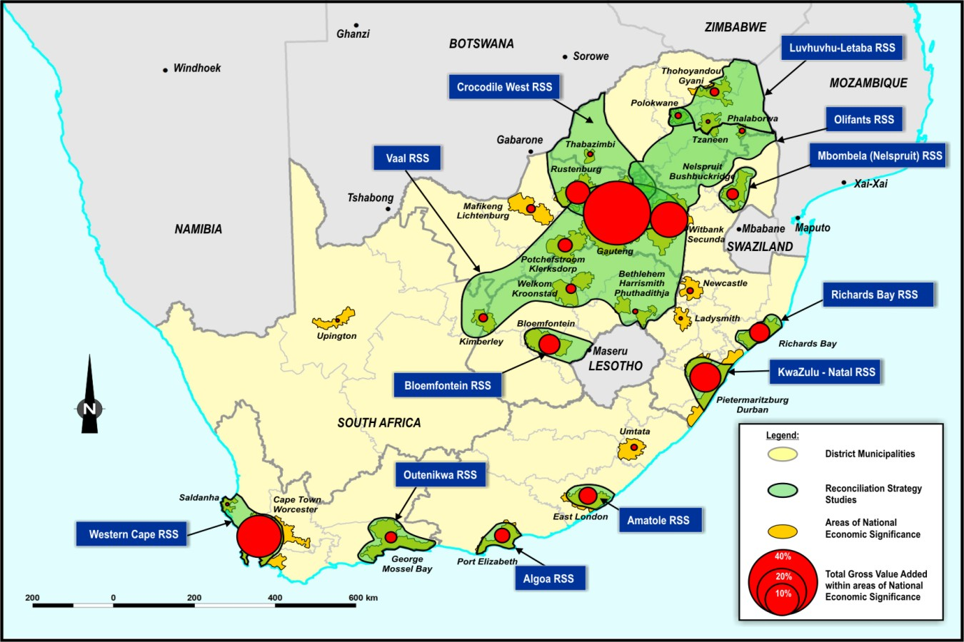
NSDP: Key demand centres

Slide 7
Reconciliation Strategies for large systems and metros
Completed
Western Cape
Amatole system
Vaal River
Crocodile West
KZN Coastal Metropolitan areas
Algoa
Bloemfontein
Outeniqua
Current
Olifants system
Mbombela system
Levuvhu-Letaba
Richards Bay

Slide 8
RICHARDS BAY RECONCILIATION STRATEGY STUDY
Water Requirements Workshop
Purpose of Study
Development of a strategy for interventions to meet possible water requirements in Richards Bay & surrounding towns up to 2040
Determine potential options / groups of options – that form reconciliation scenarios – each of which could potentially be implemented
Identify information needed & time frame to implement the strategy

Slide 9
RICHARDS BAY RECONCILIATION STRATEGY STUDY
Water Requirements Workshop
Purpose of Workshop
Opportunity for key stakeholders to comment on water use and future water requirements
Review & agree on historic/current water requirements in the supply area
Review & comment on proposed future water requirements scenarios to accommodate potential growth
Agree on scenarios to develop for further planning

Slide 10
RICHARDS BAY RECONCILIATION STRATEGY STUDY
Water Requirements Workshop
Strategy Area
Primarily the uMhlathuze Local Municipality
Extended to include RBM mining areas, Fairbreeze mine & some rural domestic supply areas
Considered factors that may expand the strategy area

Slide 11
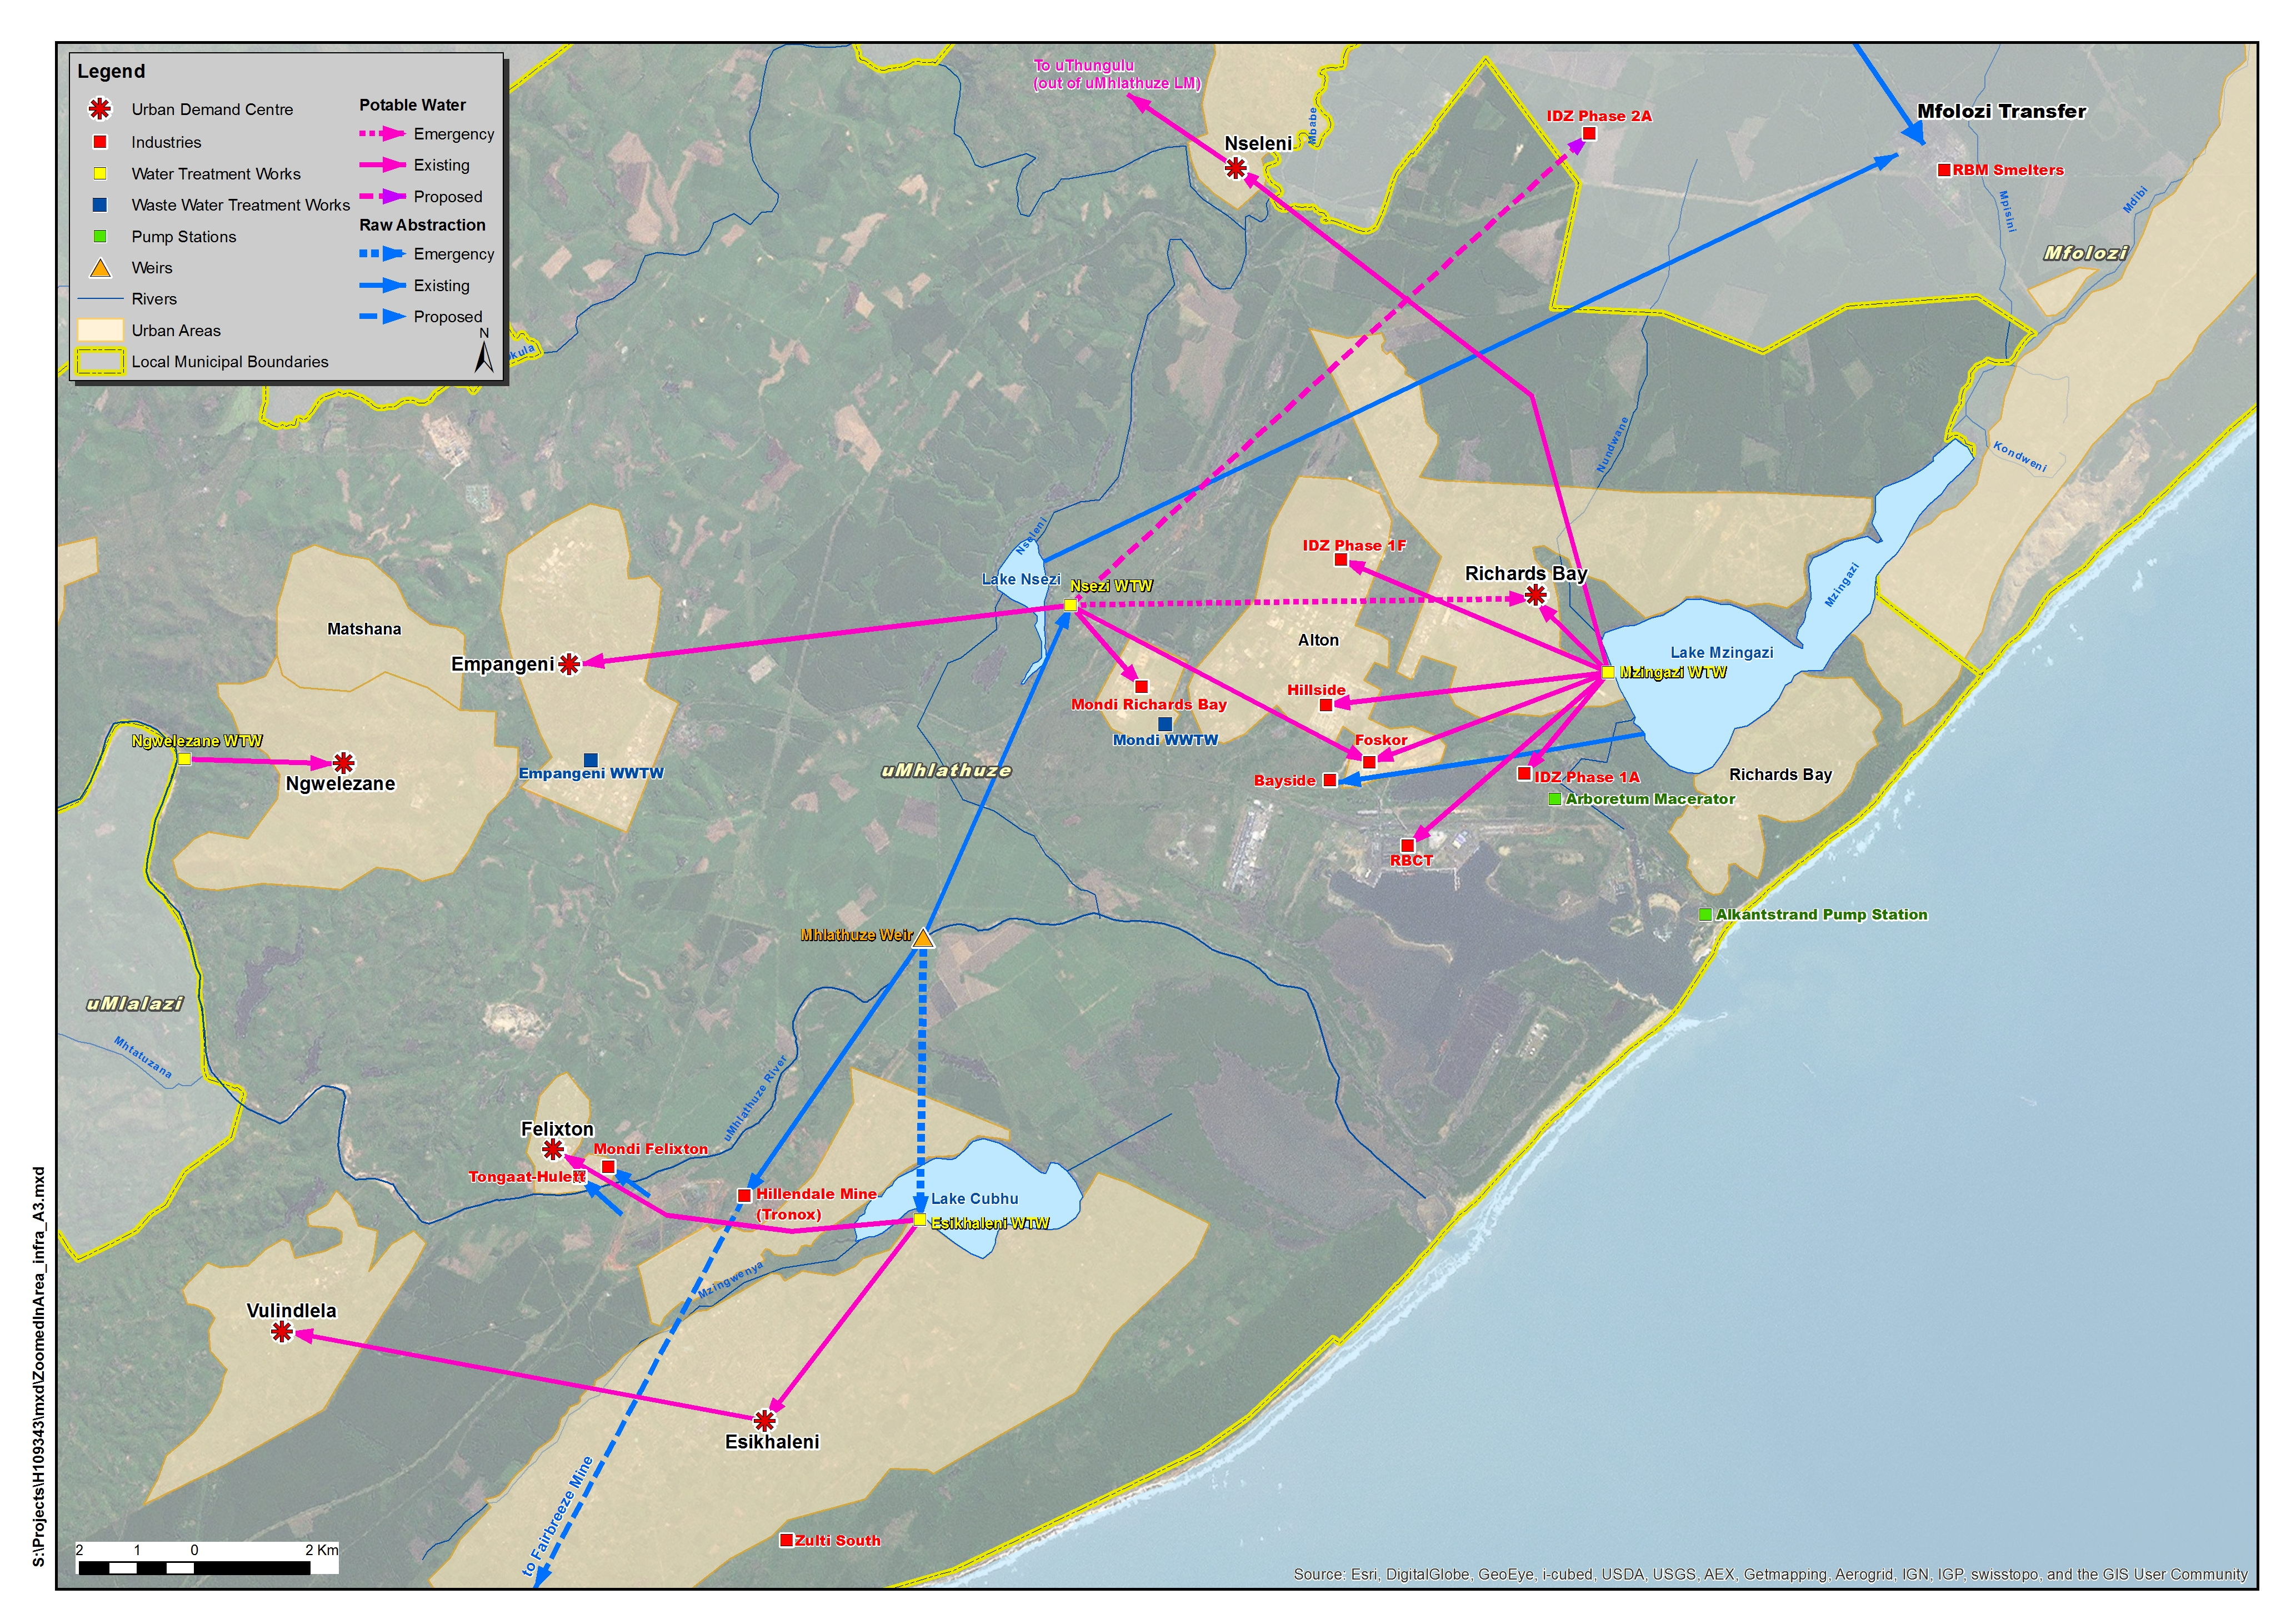
RICHARDS BAY RECONCILIATION STRATEGY STUDY
Water Requirements Workshop

Slide 12
RICHARDS BAY RECONCILIATION STRATEGY STUDY
Water Requirements Workshop
Historical & planned future water use

Slide 13
RICHARDS BAY RECONCILIATION STRATEGY STUDY
Water Requirements Workshop
Water Supply Sectors
Industrial (bulk)
Domestic (potable supply/light industrial)
Irrigation
Forestry

Slide 14
RICHARDS BAY RECONCILIATION STRATEGY STUDY
Water Requirements Workshop
Historical Water Use

Slide 15
RICHARDS BAY RECONCILIATION STRATEGY STUDY
Water Requirements Workshop
Water Efficiency
City of uMhlathuze
Up to 31 % Non-Revenue Water (NRW) in Richards Bay (5.3 Mm³/a)
Some initiatives in place (leak detection, pressure reduction)
The 5-Year Strategic Management Plan identifies 19% NRW target as practical limit of what is achievable
Metering & monitoring is critical to ensure optimum revenue collection
Further opportunities - active leakage control, water efficient fittings in new developments (through by-laws), continued raising of awareness
Successful implementation of WC/WDM requires adequate budgeting, resourcing and commitment by users and authorities

Slide 16
RICHARDS BAY RECONCILIATION STRATEGY STUDY
Water Requirements Workshop
Water Efficiency (cntd)
Mhlathuze Water
The Water Resources Management Unit raises awareness and undertakes education campaigns on water conservation
Participates in the Working for Water Program in which over 6000 hectares cleared during the 2012/13 financial year

Slide 17
RICHARDS BAY RECONCILIATION STRATEGY STUDY
Water Requirements Workshop
Water Efficiency (cntd)
Bulk industries
There is awareness of necessity for water conservation strategies
Plans include:
Internal recycling of water in processes
Stormwater capture and re-use
Increased efficiency

Slide 18
RICHARDS BAY RECONCILIATION STRATEGY STUDY
Water Requirements Workshop
Information Discrepancies
Discrepancies in historical water use values
Mondi/ Mhlathuze Water figures differ
Foskor (clarified)/ Mhlathuze Water figures differ
RBM and Tronox/ Mhlathuze Water
Discrepancies in legal water-use figures
Mondi RB allocation (DWA: 110Ml/day, MW: 100Ml/day, Mondi: 90Ml/day)
Incomplete historical usage statistics
Hillside & Bayside
Mondi Felixton
RBCT

Slide 19
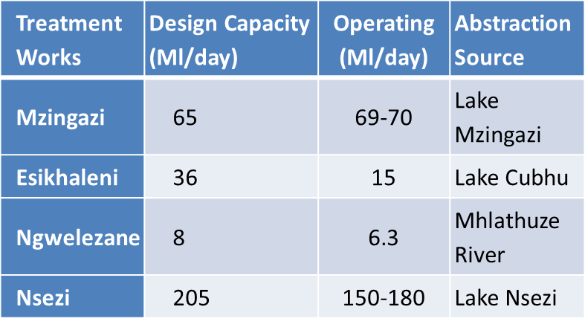
RICHARDS BAY RECONCILIATION STRATEGY STUDY
Water Requirements Workshop
Water Treatment Works
Mzingazi WTW
Nsezi WTW
Esikhaleni WTW
Ngwelezane WTW

Slide 20
RICHARDS BAY RECONCILIATION STRATEGY STUDY
Water Requirements Workshop
Major Industries
Mondi R’Bay
RBM
Tronox (Hillendale/Fairbreeze)
Foskor
Hillside & Bayside Aluminium (BHP Billiton)
Tongaat Hulett
Mondi Felixton
R’Bay Coal Terminal

Slide 21
RICHARDS BAY RECONCILIATION STRATEGY STUDY
Water Requirements Workshop
Major Industries
Mm³/a | Mondi Richards Bay | RBM - total | Foskor - total | Tronox - Hillendale | Mondi Felixton | Hillside | Tongaat Hulett | RBCT | Bayside - raw
Current Usage | 23.61 | 15.34 | 7.31 | 3.75 | 2.22 | 0.78 | 0.71 | 0.43 | 0.34
Allocation | 32.85 | 30.00 | 10.44 | 4.19 | 3.15 | - | 1.89 | - | 0.34

Slide 22
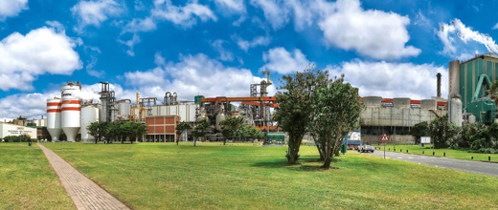
RICHARDS BAY RECONCILIATION STRATEGY STUDY
Water Requirements Workshop
Mondi Richards Bay
Allocation 90Ml/day (32.85Mm³/a)
Historical use 60-70Ml/day
Potable water supplied (Nsezi WTW)
Own WWTW (55Ml/day)
Discuss: Clarification of usage statistics

Slide 23
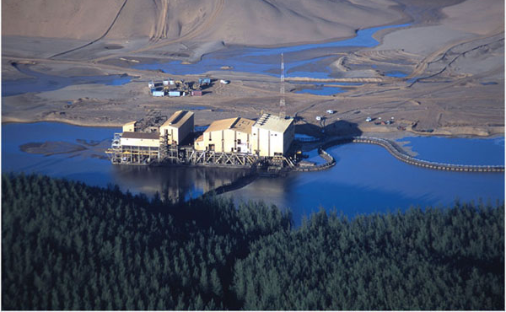
RICHARDS BAY RECONCILIATION STRATEGY STUDY
Water Requirements Workshop
Richards Bay Minerals (RBM)
Total allocation 82Ml/day (30Mm³/a)
Historical use 40-70Ml/day
Three sources for raw water abstraction:
Mfolozi River, Lake Nhlabane, Lake Nsezi
Mines and smelters
Zulti South expansion (2017)
Own WTW and WWTW
Stormwater/process water reused
Discuss: Clarification of allocations
© Thys van der Merwe

Slide 24
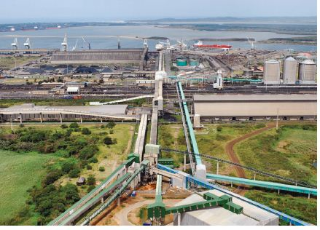
RICHARDS BAY RECONCILIATION STRATEGY STUDY
Water Requirements Workshop
Foskor – Acid Division
Total allocation 29Ml/day (10Mm³/a)
Historical use 15-30Ml/day
Two grades supplied: clarified and potable
Nsezi WTW and Mzingazi WTW
Effluent disposal by Alkantstrand Pump Station (pipelines B and C)
Use some recycled water from Hillside
Discuss: Clarification of usage statistics

Slide 25
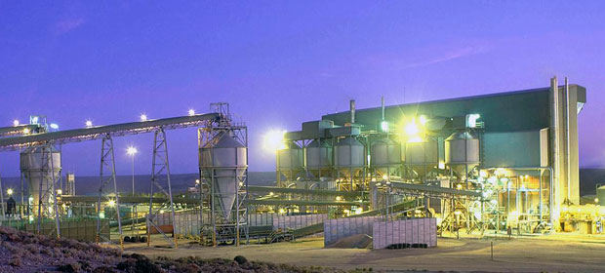
RICHARDS BAY RECONCILIATION STRATEGY STUDY
Water Requirements Workshop
Tronox (formerly Exxaro)
Current allocation (Hillendale Mine) 31.5Ml/day (11.48Mm³/a)
Fairbreeze Mine planned usage 48.0Ml/day (2017-2027)
Port Durnford Mine planned usage 55.5Ml/day (2027-2058)
Raw water abstraction from Mhlathuze Weir
Central processing plant in Empangeni
Supply from Empangeni urban supply (Nsezi WTW)
Discuss: Clarification of usage statistics

Slide 26
RICHARDS BAY RECONCILIATION STRATEGY STUDY
Water Requirements Workshop
BHP Billiton (Hillside & Bayside)
Planned phasing out of Bayside Aluminium
Hillside usage 2.14Ml/day (0.78Mm³/a)
Treated water supplied from Mzingazi WTW
Effluent disposal by Alkantstrand Pump Station (pipeline A)
Provides Foskor with some recycled water
Discuss: Clarification of usage statistics
Hillside
Bayside

Slide 27
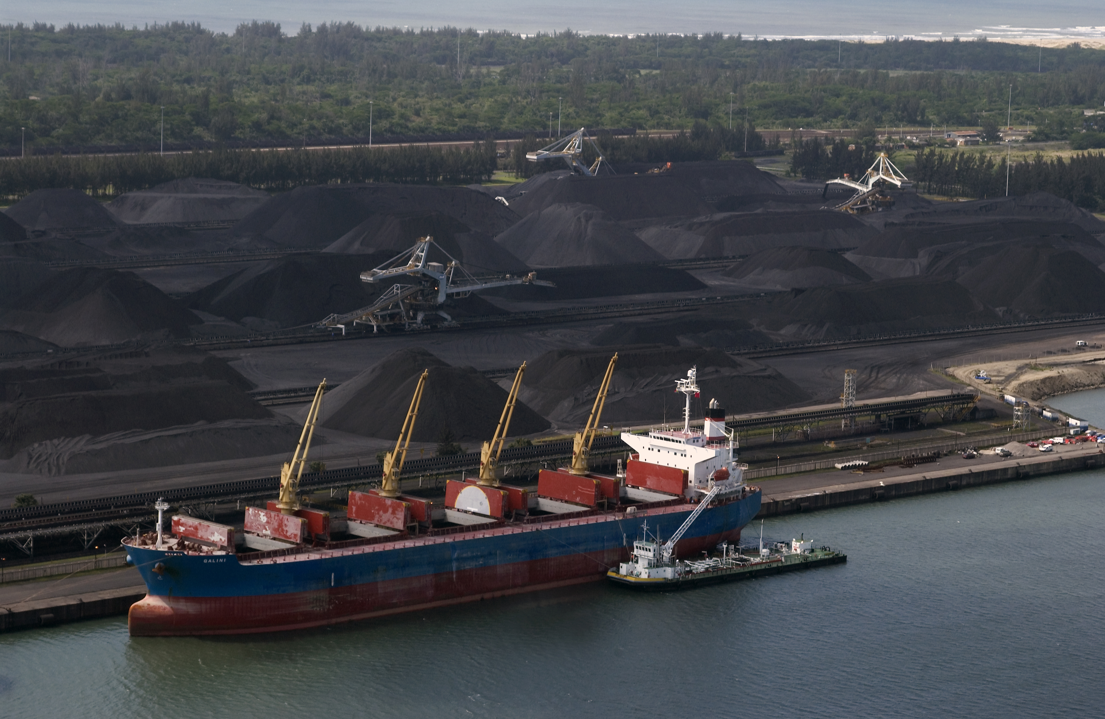
RICHARDS BAY RECONCILIATION STRATEGY STUDY
Water Requirements Workshop
Richards Bay Coal Terminal (RBCT)
Previously large user
Water use efficiency project has lead to diminished usage in recent years
Less than 1Mm³/a use
Potential future expansion

Slide 28
RICHARDS BAY RECONCILIATION STRATEGY STUDY
Water Requirements Workshop
Mondi Felixton
Tongaat Hulett
Raw water abstraction from Mhlathuze River
Use Tongaat Hulett WTW and WWTW
Usage 6.07Ml/day
Raw water abstraction from Mhlathuze River
Own WTW and WWTW
Usage 1.95Ml/day

Slide 29
RICHARDS BAY RECONCILIATION STRATEGY STUDY
Water Requirements Workshop
Industrial Development Zone (IDZ)
Future identified developments in several phases
Phase 1 in Richards Bay city area
Phases 1A, D & F
Phase 2 to the north (outside municipal area)
Earlier phases supplied by Mzingazi WTW

Slide 30
PRESENTATION TITLE HERE (if needed)
Sub-Title here (if needed)
Urban Domestic Use
Larger centres: Richards Bay, Empangeni
Smaller centres: Ngwelezane, Nseleni, Esikhaleni, Felixton, Vulindlela
Rural and tribal areas
Current Usage
Urban Centre | Annual (Mm³) | Daily (Ml)
Empangeni | 9.34 | 25.58
Richards Bay | 14.18 | 38.85
Esikhaleni | 11.16 | 30.56
Nseleni | 4.28 | 11.71
Ngwelezane | 2.54 | 6.95
Total | 41.48 | 113.66

Slide 31
RICHARDS BAY RECONCILIATION STRATEGY STUDY
Water Requirements Workshop
Irrigation
Primarily supplied from Goedertrouw Dam / Mhlathuze River
Constitutes a Government Water Control Area
Allowance made for (further) development of small irrigators
Otherwise water requirement expected to remain constant over study period
Verification and Validation process commenced 2006
66% of quota allocated
Compulsory licensing exercise
Final volume expected to be in the order of 120Mm³/a

Slide 32
RICHARDS BAY RECONCILIATION STRATEGY STUDY
Water Requirements Workshop
Other water uses
Forestry
Extensive commercial forestry
Owned mostly by Mondi and Sappi
Constitutes a stream-flow reduction activity, not a direct user
Interest for further expansion, but DWA unlikely to grant further licences
Some community projects may possibly be licensed

Slide 33
RICHARDS BAY RECONCILIATION STRATEGY STUDY
Water Requirements Workshop
Summary of current use
Ceri, please make 2 pie charts as follows:
uMhlatuze WSS – industrial & domestic use
Mhlatuze catchment water balance; i.e. increased domestic use + irrigation + forestry ???

Slide 34
RICHARDS BAY RECONCILIATION STRATEGY STUDY
Water Requirements Workshop
Usage vs Allocation

Slide 35
RICHARDS BAY RECONCILIATION STRATEGY STUDY
Water Requirements Workshop
Compulsory licensing
Commenced 2010, nearing completion
Aimed to free up allocated, but un-utilised, water
Clarification on possible reallocation of industrial water use allocations

Slide 36
RICHARDS BAY RECONCILIATION STRATEGY STUDY
Water Requirements Workshop
Current Usage
Measurable sectors: industrial, domestic, irrigation
SFRA (indirect users): forestry, dryland agriculture, alien vegetation
Sector | Usage (Mm³/a)
Industrial | 55.21
Domestic | 41.48
Irrigation | 120.00

Slide 37
RICHARDS BAY RECONCILIATION STRATEGY STUDY
Water Requirements Workshop
 |  | Current Usage |  | Allocation
Supply Sector | User | Annual (M³/a) | Daily (Ml/day) | Annual (M³/a) | Daily (Ml/day)
Industry | Mondi Richards Bay | 23.61 | 64.70 | 32.85 | 90.00
 | RBM | 15.34 | 42.02 | 30.00 | 82.19
 | Tronox - Hillendale | 3.75 | 10.28 | 11.48 | 31.46
 | Foskor | 7.31 | 20.04 | 10.44 | 28.60
 | Mondi Felixton | 2.22 | 6.07 | 3.15 | 8.63
 | Tongaat Hulett | 0.71 | 1.95 | 1.89 | 5.17
 | Bayside | 0.52 | 1.44 | 0.34 | 0.94
 | Hillside | 0.78 | 2.14 | - | -
 | RBCT | 0.43 | 1.19 | - | -
 | Tronox - Fairbreeze | - | - | 22.69 | 62.2
 | TOTAL | 55.21 | 151.25 | 90.49 | 247.93
Domestic | Empangeni | 9.34 | 25.58 | 13.51 | 37.00
 | Richards Bay | 14.18 | 38.85 | 9.13 | 25.00
 | Esikhaleni | 11.16 | 30.56 | 5.48 | 15.00
 | Nseleni | 4.28 | 11.71 | 0.00 | 0.00
 | Ngwelezane | 2.54 | 6.95 | 2.92 | 8.00
 | TOTAL | 41.48 | 113.66 | 31.03 | 85.00
 | GRAND TOTAL | 96.69 | 264.91 | 121.52 | 332.93

Slide 38
RICHARDS BAY RECONCILIATION STRATEGY STUDY
Water Requirements Workshop
Drivers of water use

Slide 39
RICHARDS BAY RECONCILIATION STRATEGY STUDY
Water Requirements Workshop
Drivers of Water Use
Rainfall
Population growth
Economic growth
UAW

Slide 40
RICHARDS BAY RECONCILIATION STRATEGY STUDY
Water Requirements Workshop
Rainfall variability

Slide 41
RICHARDS BAY RECONCILIATION STRATEGY STUDY
Water Requirements Workshop
Population growth
Population growth
Urban centres include Richards Bay, Empangeni, former KZN government townships, Felixton (home to Tongaat-Hulett and Mondi), 5 Traditional Authority areas, 21 rural settlements and 61 farms.
The current population is estimated at 378 000
The estimated population growth rate is a moderate 1, 5% p.a, influenced negatively by HIV/Aids and positively by inwards migration.

Slide 42
RICHARDS BAY RECONCILIATION STRATEGY STUDY
Water Requirements Workshop
Economic Growth
Socio-Economic considerations
Socio-economic standards in the WMA are below national average.
Over 40% of the population subject to poverty.
Municipal projects and job creation aim to alleviate poverty levels.
Unemployment ~ 19% (urban areas) and ~ 50% in rural areas.
Rapid industrial growth has not translated proportionally to job numbers.
Limited development of downstream business opportunities contributes to above phenomenon.

Slide 43
RICHARDS BAY RECONCILIATION STRATEGY STUDY
Water Requirements Workshop
Economic Growth
Economic growth
The harbour and transport infrastructure are enablers of an economy relatively more competitive than rest of RSA (ito manufacturing, transport and agriculture.
The small local consumer base and limited downstream business activities suggest that medium term growth will remain driven by large export-orientated industrial developments.
The success of the IDZ is subject to market influences, electricity price and stability of supply, and stable economic environment for investors.

Slide 44
RICHARDS BAY RECONCILIATION STRATEGY STUDY
Water Requirements Workshop
Scenarios

Slide 45
RICHARDS BAY RECONCILIATION STRATEGY STUDY
Water Requirements Workshop
Future Water Requirements by Sector
Supply Sector | Users
Current industries (fixed) | Mondi R’Bay, Mondi Felixton RBM, Foskor, Hillside Aluminium, Bayside Aluminium potable , Tongaat Hulett
Current industries (variable) | Tronox Hillendale & Fairbreeze, Bayside Aluminium, RBCT/harbour
New industries (IDZ) | IDZ identified new industries (Phases 1 and 2)
New industries (other) | Further new industries/mines (Jindal mine etc.)
Urban (domestic & light industrial) | Increased supply from WTWs in City of uMhlatuze
 | Increased supply to other areas in or from Mhlatuze catchment
 | Significant expansion outside municipal boundary: Mtubatuba / Mpukunyoni Scheme from Nseleni WTW
Irrigation | Existing irrigation after compulsory licensing
 | New irrigation (no growth allowed for)
SFRAs (plantation forestry) | Existing SFRAs (no growth allowed for)
Discuss Table 3.3 on page 19 of Workshop BID

Slide 46
RICHARDS BAY RECONCILIATION STRATEGY STUDY
Water Requirements Workshop
Industrial – fixed requirements (Mm³/a)
Supply Sector | User | Alloca-tion | Use 2013 | Notes on future water requirements
Industries Fixed require-ments | Mondi R’Bay | 32.85 | 25.55 | Allow allocation over full period
 | Mondi Felixton | 3.15 | 2.22 | Allow allocation over full period
 | RBM – total (Mfolozi, Nhlabane, Nsezi) | 30.00 | 24.71 | Allow 30 Mm³/a for full period. Assume 30% supply from Mfolozi River
 | Foskor - clarified | 5.48 | 4.67 | Allow allocation over full period
 | Foskor - potable | 4.96 | 3.41 | Allow allocation over full period
 | Hillside Aluminium | - | 0.78 | Current use continues over full period
 | Bayside Alumi-nium potable | - | 0.18 | Allow 30% of current use over full period
 | Tongaat Hulett, Felixton | 1.89 | 0.79 | Full allocation over period: potential increased use of 1 million m³
Discuss Table 3.3 on page 19 of Workshop BID

Slide 47
RICHARDS BAY RECONCILIATION STRATEGY STUDY
Water Requirements Workshop
Industrial – Variable Requirements (Mm³/a)
Supply Sector | User | Alloca-tion | Use 2013 | Notes on future water requirements
Industries variable | Tronox - Hillendale | 11.48 | 3.77 | Mine closing with rehabilitation being done – phase out over 3 yrs.
requirements | Tronox - Fairbreeze | 22.69 | - | 48.8 Ml/d from 2017 to 2027 for Fairbreeze. 55Ml/d thereafter for Port Durnford mine
 | Bayside Aluminium raw | - | 0.34 | Raw water: phase out over 3 yrs, starting with 30% of current use.
 | RBCT and harbour | - | 0.26 | Current use continues until 2020 when it increases by 20%
Discuss Table 3.3 on page 19 of Workshop BID

Slide 48
RICHARDS BAY RECONCILIATION STRATEGY STUDY
Water Requirements Workshop
New Industrial Requirements (Mm³/a)
Supply Sector | User | Notes on future water requirements
New industrial users | IDZ planning | According to IDZ Phases 1 & 2 (incl. Pulp United as part of Phase 1D) Scenarios of 25%, 50%, 75% and 100% of IDZ planning
 | Further new (Jindal mine etc.) | Scenarios of 0%, 1%, 2% additional growth
Discuss Table 3.3 on page 19 of Workshop BID

Slide 49
RICHARDS BAY RECONCILIATION STRATEGY STUDY
Water Requirements Workshop
Urban/potable Requirements (Mm³/a)
Supply Sector | User | Alloca-tion | Use 2013 | Notes on future water requirements
Urban (domestic / light industrial) | Supply from WTWs in uMhlatuze LM | 31.0+ municipal | 41.5 | Scenarios of 1%, 2%, 3.5% growth
 | Increased supply to other areas located in or supplied from Mhlatuze catchment | 5.0 | 5.5 | Scenarios of 1%, 2%, 3% and 4% growth
 | Significant expansion outside municipal boundary | - | - | Planning for Mtubatuba / Mpukunyoni Scheme from Nseleni WTW
Discuss Table 3.3 on page 19 of Workshop BID

Slide 50
RICHARDS BAY RECONCILIATION STRATEGY STUDY
Water Requirements Workshop
Irrigation & Forestry Requirements (Mm³/a)
Supply Sector | User | Alloca-tion | Use 2013 | Notes on future water requirements
Irrigation | Existing irrigation after compulsory licensing | 120 |  | Revised allocations over full period
 | New irrigation | - | - | Increased use not included
SFRAs (forestry) | Existing SFRAs | - | - | Possibility for doubling of forestry over period – not included Possibility of increased dryland sugar cane – not included
Discuss Table 3.3 on page 19 of Workshop BID

Slide 51
Population growth scenarios
3.5 % pa
High
Population number
0.5 % pa
Low
350 000
2014
Years
2040

Slide 52
Economic growth scenarios
6 % pa ?
High
GGP (Rands million)
Low
1 % pa
2014
2040
Years

Slide 53
Per capita income
High economic growth rate
Low population growth rate
GGP per capita
Low economic growth rate
High population growth rate
Years

Slide 54
Translating population and economic growth into water demand
High eco
High pop
High eco
Low pop
Low eco
Low pop
Water use
1970
2014
2040
Years

Slide 55
Forecasts in context
Key Factors affecting forecast:
Starting point
Uptake in IDZ
Water Management (WC/WDM, losses, billing, credit control)
Historic
Water use
Years

Slide 56
RICHARDS BAY RECONCILIATION STRATEGY STUDY
Water Requirements Workshop
Future Water Requirement Scenarios
Scenario | Water requirement component
 | Current industries (fixed & variable) | New identified IDZ industries | Further new industries (% additional growth) | Municipal Urban/ domestic (% growth) | Increased domestic supply in Mhlatuze catchment (% growth) | Increased domestic supply: Mtubatuba Scheme | Irrigation | WC/WDM (% saving on current use; phased in over 10 yrs.)
Sc 1: Low growth | ✓ | 25% | 0% | 1% | 1% | No | ✓ | 0%
Sc 2: Low-Medium growth | ✓ | 50% | 0.5% | 1% | 2% | No | ✓ | 0%
Sc 3: Medium growth | ✓ | 75% | 1% | 2% | 3% | Yes | ✓ | 0%
Sc 4: High growth | ✓ | 100% | 2% | 3.5% | 4% | Yes | ✓ | 0%
Sc 5: Water Efficient | ✓ | 75% | 1% | 2% | 3% | Yes | ✓ | Urban: 15% Industrial: 10%
Discuss Table 3.4 on page 20 of Workshop BID

Slide 57
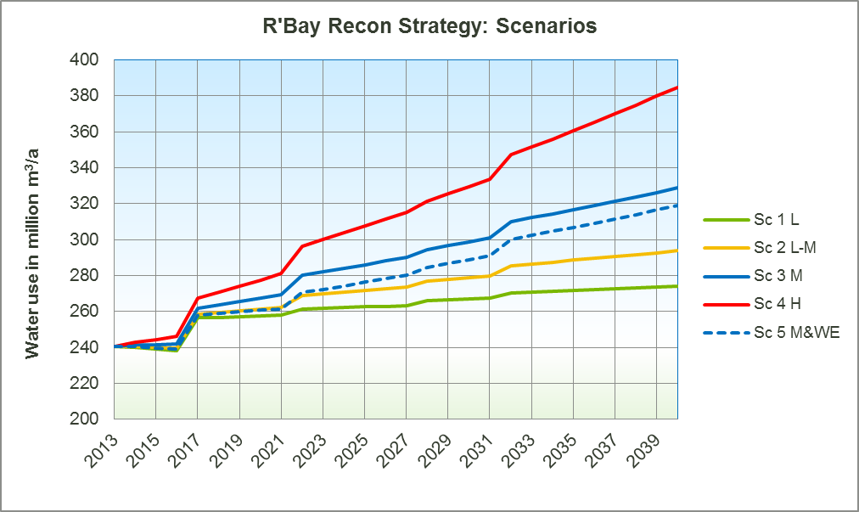
RICHARDS BAY RECONCILIATION STRATEGY STUDY
Water Requirements Workshop
Findings
IDZ expansion
IDZ expansion
Interval between old Tronox/ RBM mines closing and new mines commencing

Slide 58
RICHARDS BAY RECONCILIATION STRATEGY STUDY
Water Requirements Workshop
Way Forward
Source further information needed
Refine some water requirements following the workshop
Update scenarios as agreed
Write draft report & disseminate for comment

Slide 59
- Thank you -

Slide 60
Additional Slides

Slide 61
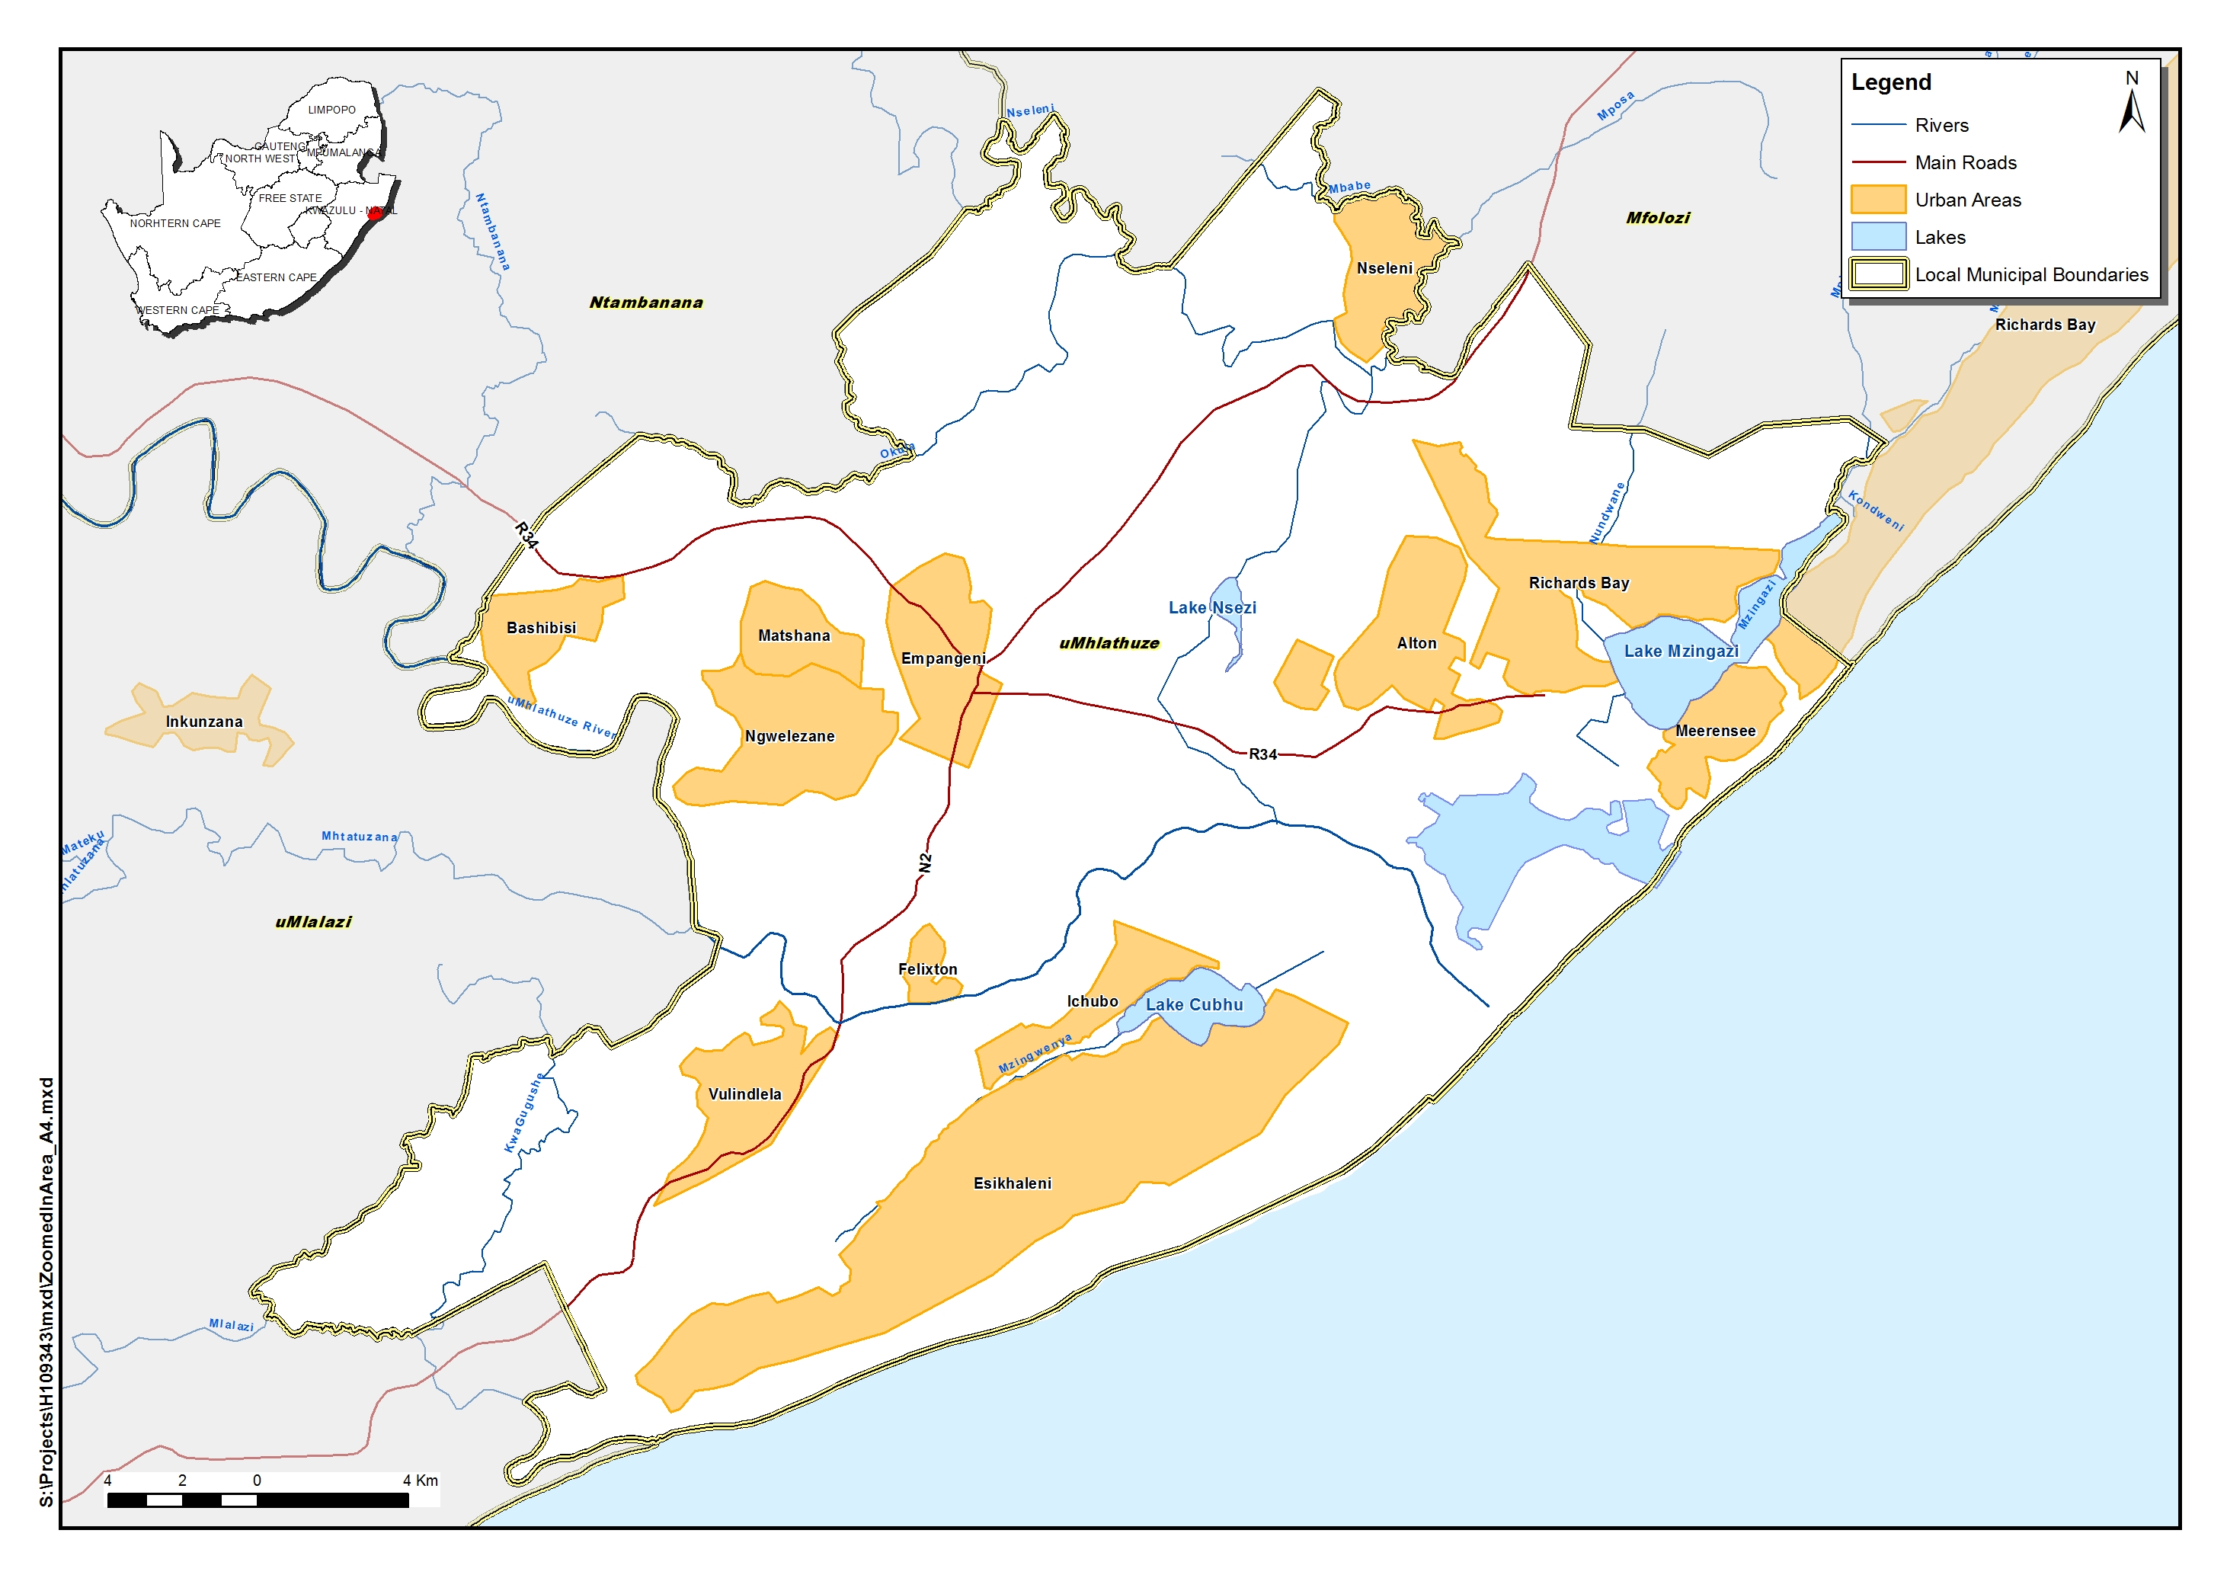
Locality Map of the City of uMhlathuze Municipality
RICHARDS BAY RECONCILIATION STRATEGY STUDY
Water Requirements Workshop

Slide 62
RICHARDS BAY RECONCILIATION STRATEGY STUDY
Water Requirements Workshop
Water Efficiency (cntd)
Foskor
Utilize storm water captured on their own sites for their two phosphoric acid plants (1800m³ month)
They also utilize storm water from BHP Billiton (Hillside) to reduce their municipal raw water uptake
Foskor are developing their own water reduction and efficiency plan for implementation

Slide 63
RICHARDS BAY RECONCILIATION STRATEGY STUDY
Water Requirements Workshop
Water Efficiency (cntd)
Mondi
Mondi implemented a program from 2005 which included a targeted reduction in their fresh water consumption by approximately 15,000m³ per day.
A Water Reduction Task Team monitors water consumption against targets set within the Mill and attempts to remedy over-use

Slide 64
RICHARDS BAY RECONCILIATION STRATEGY STUDY
Water Requirements Workshop
Water Efficiency (cntd)
Richards Bay Coal Terminal (RBTC)
RBCT’s Environmental Systems Upgrade Project (ESUP) was commissioned in 2009
Storm water and water collected from the coal stockpiles is channeled into settling ponds
This recycled water is used for suppression of dust
Their overall consumption of potable reduced by 75% (2010-2012)

Slide 65
RICHARDS BAY RECONCILIATION STRATEGY STUDY
Water Requirements Workshop
Water Efficiency (cntd)
Richards Bay Minerals (RBM)
Awarded first place by the DWA at the WC/WDM Sector Awards 2013
RBM invested in reducing freshwater abstraction & improving both water recycling and efficiency of use
Process water from smelting and processing activities is re-used at the mine
Their Water Management Plan identifies improved storm and process water capturing; expansion of their water treatment plant; and addressing water efficiency of tails stacking operations

Slide 66
RICHARDS BAY RECONCILIATION STRATEGY STUDY
Water Requirements Workshop
Water Efficiency (cntd)
The Industrial Development Zone (IDZ)
The Environmental Management Framework for the Port Expansion and the IDZ recognizes the need to ensure that appropriate demand-side management measures are implemented during the development of the IDZ
It also has a strong focus though design requirements on the protection of water quality, both aquatic and marine

Slide 67
RICHARDS BAY RECONCILIATION STRATEGY STUDY
Water Requirements Workshop
Type of Use | User | Water Quality | Treatment Works | Source | Supplier
Industrial | Bayside Aluminium | Raw |  | Lake Mzingazi | City of uMhlathuze
 |  | Potable | Mzingazi WTW | Lake Mzingazi | City of uMhlathuze
 | Hillside Aluminium | Potable | Mzingazi WTW | Lake Mzingazi | City of uMhlathuze
 | RBCT | Potable | Mzingazi WTW | Lake Mzingazi | City of uMhlathuze
 | Tongaat-Hulett and Mondi Felixton | Potable Raw | Tongaat Hulett WTW | Lake Cubhu Mhlathuze River | City of uMhlathuze
 | Mondi | Potable | Nsezi WTW | Lake Nsezi and Mhlathuze Weir | Mhlathuze Water
 | Foskor | Clarified | Nsezi WTW | Lake Nsezi and Mhlathuze Weir | Mhlathuze Water
 |  | Potable | Mzingazi WTW | Lake Mzingazi
 | Tronox (Hillendale) | Raw |  | Mhlathuze Weir | Mhlathuze Water
 | RBM | Raw |  | Lake Nsezi | Mhlathuze Water
 |  | Raw |  | Mfolozi River | RBM
 |  | Raw |  | Lake Nhlabane | RBM
Domestic | Richards Bay | Potable | Mzingazi TW | Lake Mzingazi | City of uMhlathuze
 | Richards Bay (supplementary supply) | Potable | Nsezi TW | Lake Nsezi and Mhlathuze Weir | Mhlathuze Water
 | Empangeni | Potable | Nsezi TW | Lake Nsezi and Mhlathuze Weir | Mhlathuze Water
 | Nseleni | Potable | Mzingazi TW | Lake Mzingazi | City of uMhlathuze
 | Esikhaleni, Felixton and Vulindlela | Potable | Esikhaleni TW | Lake Cubhu | City of uMhlathuze
 | Ngwelezane | Potable | Ngwelezane TW | Mhlathuze River | City of uMhlathuze

Slide 68
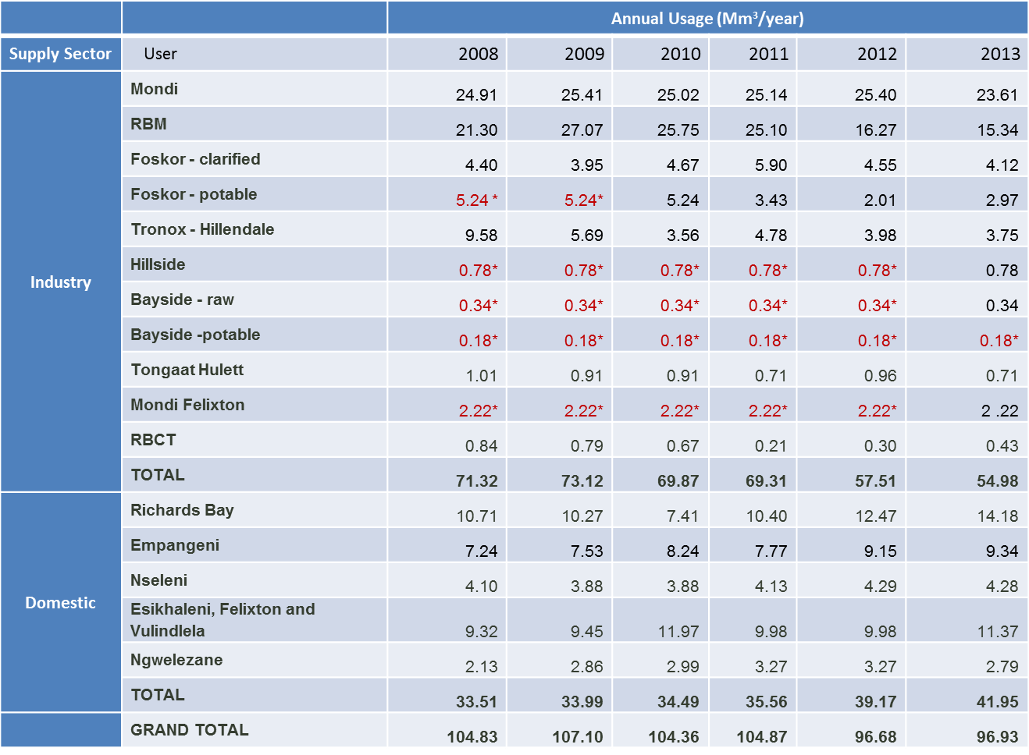
RICHARDS BAY RECONCILIATION STRATEGY STUDY
Water Requirements Workshop

